Slide 1
Chemical Reactions
Mrs. Charniauskaya 2016-2017

Slide 2
Plan for the Unit
Writing chemical equations
Reactants vs. products, writing equations from word problems, diatomics, states of reactants/products (s, l, g, aq)
Balancing chemical equations
Counting atoms, Law of Conservation Mass
Types of reactions
Combination/synthesis, decomposition, single-replacement, double-replacement, combustion
Predicting products of a reaction (based on type)
The Activity Series
Precipitates
Assessments
Common Unit Test
Types of Reactions Lab

Slide 3
Learning Objectives
Students will be able to:
Explain what happens with the reactants during chemical reaction.
Express a chemical reaction in equation form.
Balance chemical equations.
Demonstrate the law of conservation of matter by balancing chemical equations.
Compare and contrast types of chemical reactions.
Predict the products of a chemical reaction.
Explain how do the reactants and products determine the type of reaction.
Explain the types of chemical reactions.

Slide 4
Bell Work:
1. Names of what kind of ions have endings –ate or –ite?
2. Write the formulas for the following:
Aluminum Oxide
Dinitrogen trioxide

Slide 5
What do you think a chemical reaction is?

Slide 6
How can I chemically describe the way my car rusts?

Slide 7
How can I describe this process chemically?

Slide 8
Chemical Reactions
Chemical reaction is a process in which the atoms of one or more substances are rearranged to form different substances with new chemical composition and different physical and chemical properties.
During chemical reaction the chemical bonds in the reactants break and new bonds are created.
Chemical equation represents chemical reaction.
Reactants are starting substances.
Products are the substances formed during the reaction.
NaOH + HCl NaCl + H₂O
reactant 1 + reactant 2 product 1 + product 2

Slide 9
Example: how to write chemical equation from word problems.
Silver nitrate reacts with sodium chloride to form silver chloride and sodium nitrate.
What are the reactants?
What are the products?
Write the chemical formulas for each substance.
Put the chemical formulas into the chemical equation.

Slide 10
Example
Identify reactants and products and write the equation for the following chemical reaction:
Sodium phosphate and potassium hydroxide react to form sodium hydroxide and potassium phosphate.

Slide 11
Example
Identify reactants and products and write the equation for the following chemical reaction:
Calcium carbonate and hydrochloric acid react to form calcium chloride and carbonic acid.
CaCO₃ + HCl → CaCl₂ + H₂CO₃

Slide 12
Under high temperature calcium carbonate decomposes into calcium oxide and carbon dioxide.

Slide 13
Diatomic Elements
Diatomic elements are made from two atoms of the same element.
Diatomic elements exist in nature as diatomic molecules because the molecules formed are more stable than individual atoms.
Diatomic Elements | Chemical Formula
Hydrogen | H₂
Nitrogen | N₂
Oxygen | O₂
Fluorine | F₂
Chlorine | Cl₂
Bromine | Br₂
Iodine | I₂

Slide 14
Hydrogen and Oxygen react to form water.
Correct
Incorrect
H₂ + O₂ → H₂O
H + O → H₂O

Slide 15
Diatomic Elements Example
Aluminum bromide reacts with chlorine to form aluminum chloride and bromine.

Slide 16
Complete Chemical Equations Examples
Mg_{(s)} + 2H₂O_{(l)} → Mg(OH)_{2 (s)} + H_{2(g)}

Slide 17
Complete Chemical Equation
Physical State of Reactant and Product | Subscript used in a chemical equation
solid | s
liquid | l
gas | g
Aqueous, Dissolved in water, a solution | aq
Precipitate (solid) | s
Complete chemical equations include the physical states of the reactants and products.
The states are written in subscript after the substance (s, l, g, aq)
Aqueous = dissolved in water (solutions & acids)

Slide 18
Precipitate: A solid formed from a reaction of two aqueous solutions.
AgNO_{3 (aq)} + NaCl_{(aq)} → AgCl_{(s)} + NaNO_{3 (aq)}

Slide 19
Example
Identify reactants and products and write the equation for the following chemical reaction:
Aqueous mercury (I) nitrate reacts with aqueous potassium chloride to produce aqueous potassium nitrate and a mercury (I) chloride precipitate.

Slide 20
Example
Identify reactants and products and write the equation for the following chemical reaction:
Silver nitrate dissolved in water reacts with copper metal to produce silver metal and aqueous copper (II) nitrate.

Slide 21
Discussion Questions
Explain what happens with energy during endothermic and exothermic reactions.
Think why some reactions are endothermic and some are exothermic?
What is a catalyst?

Slide 22
Heat in Chemical Reaction
In chemical reactions, bonds in reactant molecules are broken and new bonds are formed as product molecules form.
The total energy change of the chemical reaction is determined from the energy of the bonds broken and formed.
∆H_{reaction} = ∆H_{products} - ∆H_{reactants}
Endothermic reaction occurs when a greater amount of energy is required to break the existing bonds than it is released when the new bonds form in the product molecules.
∆H_{products} ˃ ∆H_{reactants}
Exothermic reactions occur when more energy is released forming new bonds than it is required to break bonds in the initial reactants.
∆H_{products} ˂ ∆H_{reactants}

Slide 23
Exo- and Endo- thermic Reactions

Slide 24
Catalyst? What is that?
A substance that speeds up a reaction, without being used up or changed by the reaction.
C₂H₄ + H₂ C₂H₆
N₂ + 3H₂ 2NH₃
Catalysts
reduce the amount of energy needed for a reaction to occur.
work by helping bonds to break more easily the reactants need less energy to start reacting.
Many reactions cannot take place without catalysts.
Enzymes are biological/protein catalysts in your body.
Catalyst
Pd
Fe

Slide 25
Catalysts are not changed by the reaction.
There is always as much catalyst present at the end of a reaction as there was at the start.
Catalysts work by helping bonds to break more easily; therefore, the reactants need less energy to react and the reaction is faster.
A catalyst can be recovered and used again and again.
Cars have catalytic converters; contact lenses are cleaned using a catalyzed chemical reaction; and there are catalysts in the food you eat every day.
There are also thousands of catalysts in your body without which you could not live. These biological catalysts are called enzymes.

Slide 26
Write the complete chemical equation and balance it
Solid calcium hydroxide is combined with phosphoric acid to produce water and calcium phosphate as a precipitate.

Slide 27
What is missing?
H₂ + O₂ → H₂O
H-H + O=O $→$ O + O ????
H H

Slide 28
Balancing Chemical Equation

Slide 29
Balancing Chemical Equations
The balanced equation for a chemical reaction reflects the law of conservation of matter.
Applied to chemical reaction:
2H₂ + O₂ 2H₂O
Total mass of reactants
Total mass of products

Slide 30
Balancing Chemical Equations
2H₂ + O₂ →2 H₂O
Number of atoms of each element on the reactants side must equal to the number of atoms of each element of the product side.
2Fe + 3Cl₂ $→$ 2FeCl₃
Coefficients

Slide 31
2Fe + 3Cl₂ $→$ 2FeCl₃
Coefficient
is a whole number
is written in front of the particle (atom, molecule, formula unit) of a reactant or product.
tells the smallest number of particles of the substance involved in the reaction.

Slide 32
Steps for Balancing Chemical Equations
1. Write the chemical equation.
2. Count the atoms of the elements in the reactants.
3. Count the atoms of the elements in the products.
4. Change the coefficients to make the number of atoms of each element equal on both sides of the equation.
5. Write the coefficients in their possible lowest ratio.
6. Check your work.

Slide 33
Example
___N₂(g) + ___H₂(g) → ___NH₃(g)
 | Reactants Side | Products Side
N | 2 | 1
H | 2 | 3

Slide 34
Example
___N₂(g) + ___H₂(g) → 2 NH₃(g)
 | Reactants Side | Products Side
N | 2 | 1 2
H | 2 | 3 6

Slide 35
Example
___N₂(g) + 3H₂(g) → 2NH₃(g)
 | Reactants Side | Products Side
N | 2 | 1 2
H | 2 6 | 3 6

Slide 36
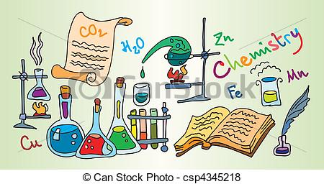
Write and Balance Chemical Equation
1. Zinc and lead (II) nitrate solution react to form aqueous zinc nitrate and lead.
2. A solution of aluminum bromide and chlorine gas react to form aqueous aluminum chloride and bromine gas.

Slide 37
1. Two solutions of sodium phosphate and calcium chloride combine to form calcium phosphate precipitate and aqueous sodium chloride.
2. The production of solid potassium chloride from the reaction of potassium metal and chlorine gas.
3. Aluminum and hydrochloric acid react to form dissolved aluminum chloride and hydrogen gas.
4. Calcium hydroxide is combined with phosphoric acid to produce water and calcium phosphate as a precipitate.

Slide 38
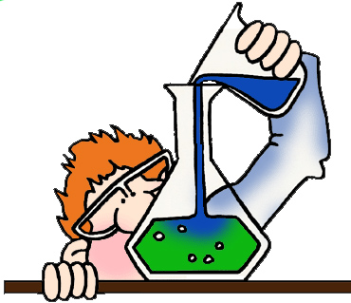
1. When lithium hydroxide pellets are added to sulfuric acid, insoluble lithium sulfate and water are formed.
2. If a copper coil is placed into a solution of silver nitrate, silver crystals form. Additionally, highly soluble copper (I) nitrate is produced.
3. When crystalline C₆H₁₂O₆ is burned with oxygen, carbon dioxide and water vapor are formed.

Slide 39
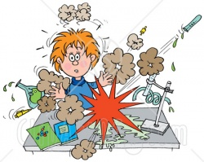
Water, copper (II) sulfate solution, and dangerous sulfur dioxide vapor can result if copper metal is added to sulfuric acid.

Slide 40
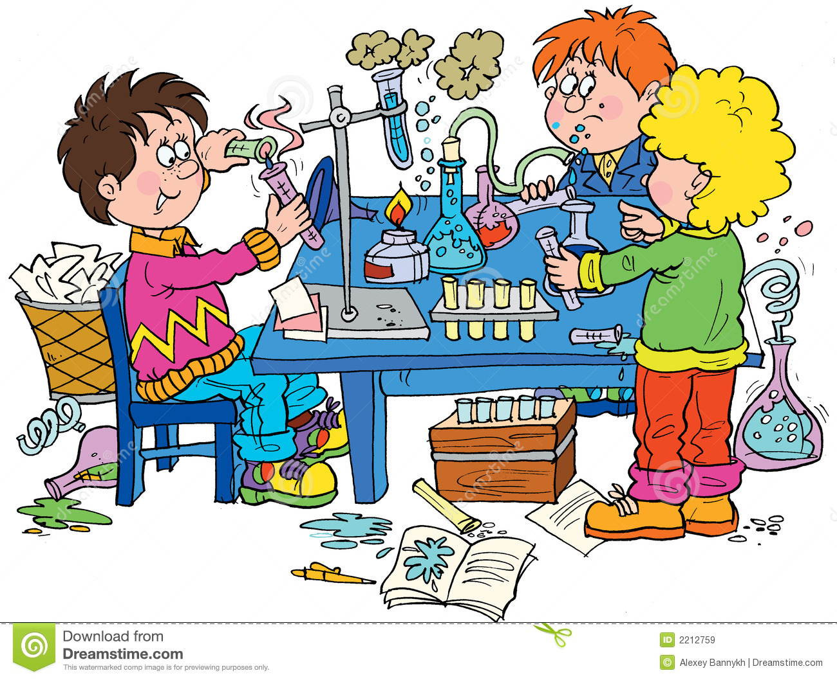

Slide 41
Classifying Chemical Reactions
Synthesis Reactions
Combustion
Decomposition
Single replacement
Double replacement

Slide 42
Determine the type of reaction
Mg_{(s)} + CuSO_{4(aq)} $→$ MgSO_{4(aq)} + Cu_{(s)}
2Na_{(s)} + Cl_{2(g)} $→$ 2NaCl
2 NaOH_{(aq)} + CuCl_{2(aq)} → Cu(OH)_{2(s)} + 2 NaCl_{(aq)}
2 NaN_{3(s)} $→$ 2Na_{(s)} + 3 N_{2(s)}
CH_{4(g)} + 2 O_{2(g)} $→$ CO_{2(g)} + 2 H₂O_{(g)} + heat
Zn_{(s)} + PbCl_{2(aq)} $→$ZnCl_{2(aq)} + Pb_{(aq)}

Slide 43
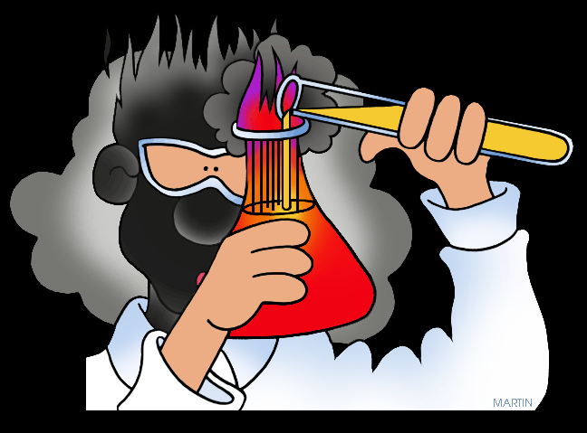
Synthesis/Combination Reactions
Two reactants combine to produce one new compound.
A + B $→$AB
CaO_{(s)} + H₂O_{(l)} $→$ Ca(OH)_{2(s)}
2Na_{(s)} + Cl_{2(g)} $→$ 2NaCl
2SO_{2(g)} + O_{2(g)} $→$ 2SO_{3(g)}
2H_{2(g)} + O_{2(g)} $→$ H₂O_{(g)}
C_{(s)} + O_{2(g)} $→$ CO_{2(s)}

Slide 44
Predict the products for the reactions of
1. Sodium and fluorine.
2. Oxygen and iron. Assume that the charge of iron cation in the corresponding product is +3.
3. Calcium and iodine.
4. Potassium and Sulfur.

Slide 45
Decomposition
In a decomposition reaction a single compound breaks down into two or more new compounds.
Decomposition often requires an energy source: heat, light or electricity.
AB $→$ A + B
2 NH₄NO_{3(s)} $→$ N₂O_{(s)} + 2 H₂O_{(g)}
2 NaN_{3(s)} $→$ 2Na_{(s)} + 3 N_{2(s)}

Slide 46
Write equations for the following decomposition reactions:
Aluminum oxide decomposes when electricity is passed through it.
Nickel (II) hydroxide decomposes to produce nickel (II) oxide and water.
Heating sodium bicarbonate produces sodium carbonate, carbon dioxide, and water.

Slide 47
Predict the products to the following reactions
H₂O $electricity$
NaH $→$
AlCl₃ $electricity$

Slide 48
Combustion
In a combustion reaction, hydrocarbons react with oxygen, always producing carbon dioxide and water and releasing a large amount of energy in the form of light and heat.
Hydrocarbons C_{x}H_{y} are substances composed of carbon and hydrogen (x and y are any numbers).
General Equation:
C_{x}H_{y} + O₂ $→$ CO₂ + H₂O + energy
Example:
CH_{4(g)} + 2 O_{2(g)} $→$ CO_{2(g)} + 2 H₂O_{(g)} + heat

Slide 49
Combustion

Slide 51
Try to predict the products, write the reaction and balance it.
Ethane burns in the air.
C₂H₆ + O₂
Propane (C₃H₈) burns.
Octane (C₈H₁₈) burns.

Slide 52
Write, balance and classify chemical reactions:
The solid aluminum and sulfur react to produce aluminum sulfide.
Ethane gas (C₂H₈) burns in air.
Water and dinitrogen pentoxide gas react to produce aqueous nitric acid.
The gases nitrogen dioxide and oxygen react to produce dinitrogen pentoxide gas.

Slide 53
Replacement Reactions
Single Replacement Reactions
Replacement Reactions
Double Replacement Reactions

Slide 54
Double Replacement Reaction
Double replacement reaction is an exchange of ions between two ionic compounds.
AX_{(aq)} + BY_{(aq)} $→$ AY_{(s)} + BX_{(aq)}
2NaOH_{(aq)} + CuCl_{2(aq)} → Cu(OH)_{2(s)} + 2NaCl_{(aq)}
CaSO₄ + BaCl₂ $→$ CaCl₂ + BaSO₄

Slide 55
Chemistry, February 9, 2017
Bell Work:
Write down general equations for
Synthesis/combination reactions
Decomposition reactions
Combustion reactions
Double Replacement reactions
Single Replacement reactions
Learning Objective:
Be able to predict products for any type of reactions.
Agenda Types of Chemical reactions HW was due on 02/07/17
Bell Work
Post-lab discussion and lab report completion
Predicting products of reaction practice

Slide 56
Single Replacement Reactions
A reaction in which atoms of one element replace the atoms of another element in a compound.
A + BX $→$ AX + B
Mg_{(s)} + CuSO_{4(aq)} $→$ MgSO_{4(aq)} + Cu_{(s)}
Fe_{(s)} + CuSO_{4(aq)} $→$ FeSO_{4(aq)} + Cu_{(s)}
2Li_{(s)} + H₂O_{(l)} $→$ 2LiOH_{(aq)} + H_{2(g)}

Slide 57
Less reactive metal will not replace more reactive metal, because metals differ in their reactivities.
Li + NaCl $→$ LiCl + Na
Na + LiCl $→$ No reaction.
Sodium is less reactive and cannot replace Lithium.
How do we know if a metal more or less reactive?

Slide 58
Activities Series
The ability of element to react with another substance is called element’s reactivity.
Elements are organized in a list (Activity series) by their reactivities.
An activity series predicts
if a reaction will take place
the results of a replacement reaction.

Slide 59
Activity Series

Slide 60
Lithium
Rubidium
Potassium
Calcium
Sodium
Magnesium
Aluminum
Zinc
Chromium
Iron
Nickel
Lead
Hydrogen
Bismuth
Copper
Silver
Mercury
Platinum
Gold
Metals can only replace other metals if they are above the metal they are trying to replace.
Zn + PbCL₂ $→$ZnCl₂ + Pb
Metals above hydrogen can replace hydrogen in acids.
Zn + 2HCl $→$ ZnCl₂ + H₂
Au + HCl $→$
Metals from sodium upward will react with cold water to replace hydrogen.
2Na + 2H₂O $→$ 2NaOH + H₂
Fe, Cr, Zn and Al will react with water steam.
Higher activity
Lower activity

Slide 61
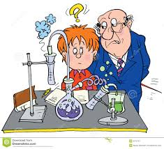
Will this reaction take place?
Ag_{(s)} + Cu(NO)_{3(aq)} $→$ ???
Fe_{(s)} + CuSO_{4(aq)} $→$ ???
Br_{2(g)} + MgCl_{2(aq)} $→$ ???
Mg_{(s)} + AlCl_{3(aq)} $→$ ???
K_{(s)} + ZnCl_{2(aq)} $→$ ???
Cl_{2(g)} + HF_{(aq)} $→$ ???
Fe_{(s)} + Na₃PO_{4(aq)} $→$ ???

Slide 62
Double Replacement Reaction
Double replacement reaction is an exchange of ions between two ionic compounds.
As a rule, two reactants are aqueous ionic compounds.
Double replacement reactions only occur when precipitate, water or gas form as one of the products.
AX_{(aq)} + BY_{(aq)} $→$ AY_{(s)} + BX_{(aq)}

Slide 63
When aqueous solutions of sodium hydroxide and copper (II) chloride are mixed, a double-replacement reaction occurs in which the precipitate copper(II) hydroxide forms.
2NaOH_{(aq)} + CuCl_{2(aq)} → Cu(OH)_{2(s)} + 2NaCl_{(aq)}
Solutions of ionic compounds
Precipitate Produced

Slide 64
Double Replacement
Water is produced:
Acids react with hydroxides (bases) to produce salts and water.
2NaOH + H₂SO₄ $→$ Na₂SO₄ + 2H₂O
Ca(OH)₂ + 2HCl $→$ CaCl₂ + 2H₂O
Acid is a compound that produces hydrogen-ion H⁺ in solution. Example: HCl, H₂SO₄
Base is a compound that produces hydroxide-ion OH⁻ in solution. Example: NaOH, Mg(OH)₂
Salt is any ionic compound that is not containing hydrogen-ion or hydroxide ion. Examples: PbI₂, FeCl₃, CaSO₄.

Slide 65
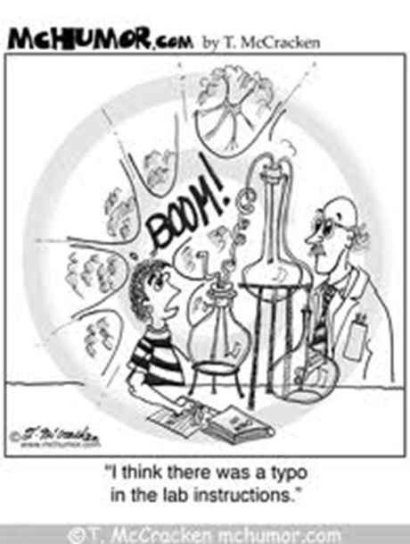
Double Replacement
Gas is produced:
Na₂CO_{3(aq)} + H₂SO_{4(aq)} $→$ Na₂SO_{4(aq)} + H₂CO_{3(aq)}
CO_{2(g)} + H₂O_{(l)}
Na₂CO_{3(aq)} + H₂SO_{4(aq)} $→$ Na₂SO_{4(aq)} + CO_{2(g)} + H₂O_{(l)}

Slide 66
Type of Reactions Lab
While performing experiments at every station:
Analyze the reactants first and try to predict what type of chemical reaction you are going to observe
Look for the signs of chemical reaction
Are you able to see, to smell, to feel the products or any other signs of chemical reaction?

Slide 67
Recognize the types of reactions for the following reactions:
Mg_{(s)} + CuSO_{4(aq)} $→$ MgSO_{4(aq)} + Cu_{(s)}
2Na_{(s)} + Cl_{2(g)} $→$ 2NaCl
2 NaOH_{(aq)} + CuCl_{2(aq)} → Cu(OH)_{2(s)} + 2 NaCl_{(aq)}
2 NaN_{3(s)} $→$ 2Na_{(s)} + 3 N_{2(s)}
CH_{4(g)} + 2 O_{2(g)} $→$ CO_{2(g)} + 2 H₂O_{(g)} + heat
Zn_{(s)} + PbCl_{2(aq)} $→$ZnCl_{2(aq)} + Pb_{(aq)}

Slide 68
Write the chemical reactions…
A solution of lead (II) nitrate is mixed with a solution of potassium iodide.
Solid zinc sulfide reacts with oxygen in the air.
Liquid butane (C₄H₁₀ ) is used as fuel to ignite a lighter.
Barium hydroxide solution is neutralized by adding hydrochloric acid.
Copper metal is placed in a solution of silver nitrate.
Sulfur burns in oxygen to make sulfur dioxide gas.
A solution of aluminum sulfate is mixed with a solution of calcium hydroxide.
Zinc metal is placed in sulfuric acid.
Aluminum powder is placed in a container filled with chlorine gas.

