Slide 1
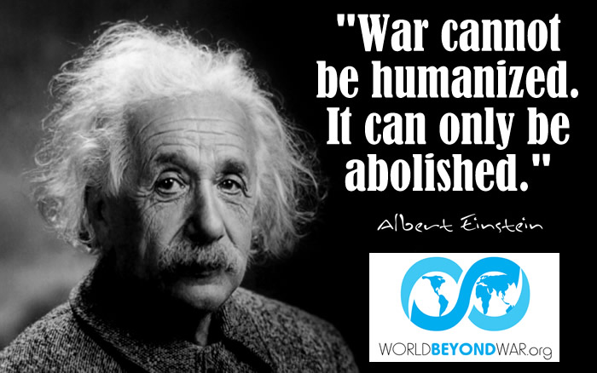
Albert Einstein

Slide 2
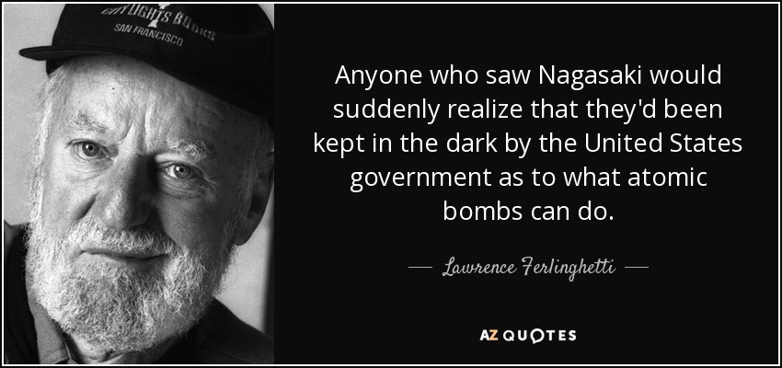
Famous Poet

Slide 3
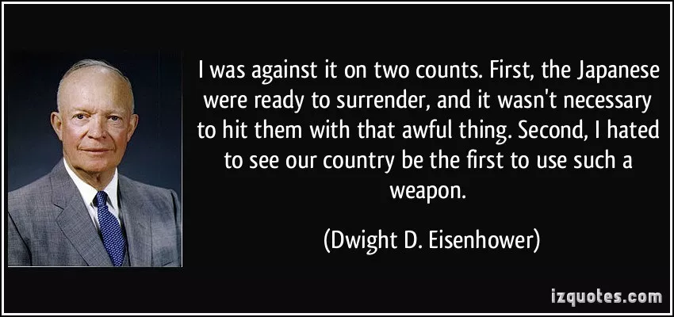
Eisenhower

Slide 4
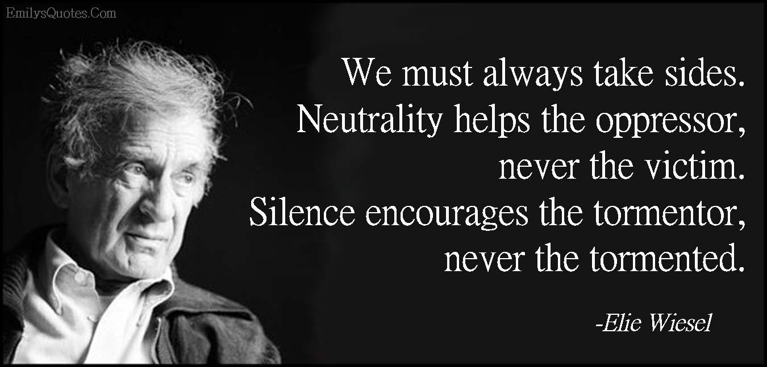
Elie Wiesel

Slide 5
Niemoller

Slide 6
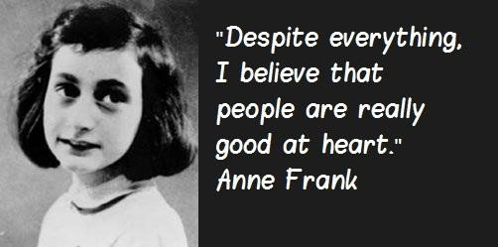
Anne Frank

