Slide 1
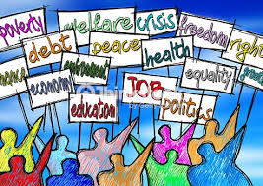
Social Issues

Slide 2
What is a social issue?
A social issue (also called a social problem or a social illness or even a social conflict) refers to an issue that influences and is opposed by a considerable number of individuals within a society.

Slide 3
Social issues are those which affect the human society as a whole. These issues pertain to human behavior, including government policies, religious conflicts, gender inequalities, economic disparities, etc.

Slide 4
Most Common Social Problems
Brainstorming!
Let’s make a list of all the social problems that we know
Write them on the board.

Slide 5
Brain Storm

Slide 6
Social Issues

Slide 7
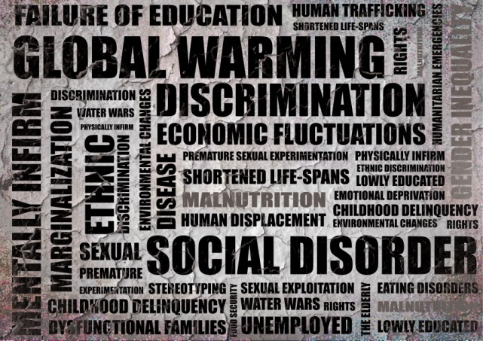
List of Social Issues in Today's Society
Global warming
Drug abuse
Gun Laws
Bullying
Immigration
Homophobia
Poverty
Women’s rights
Religion-based discrimination
Unemployment
Civil rights
Obesity
Voting

Slide 8
Social Power
Who in our society has power?
Who has priority? Provide an example.
Who creates rules and who directs them?
Do all citizen obey the rules?
What happens if someone disobey?

Slide 9
Knock Down the House

Slide 10
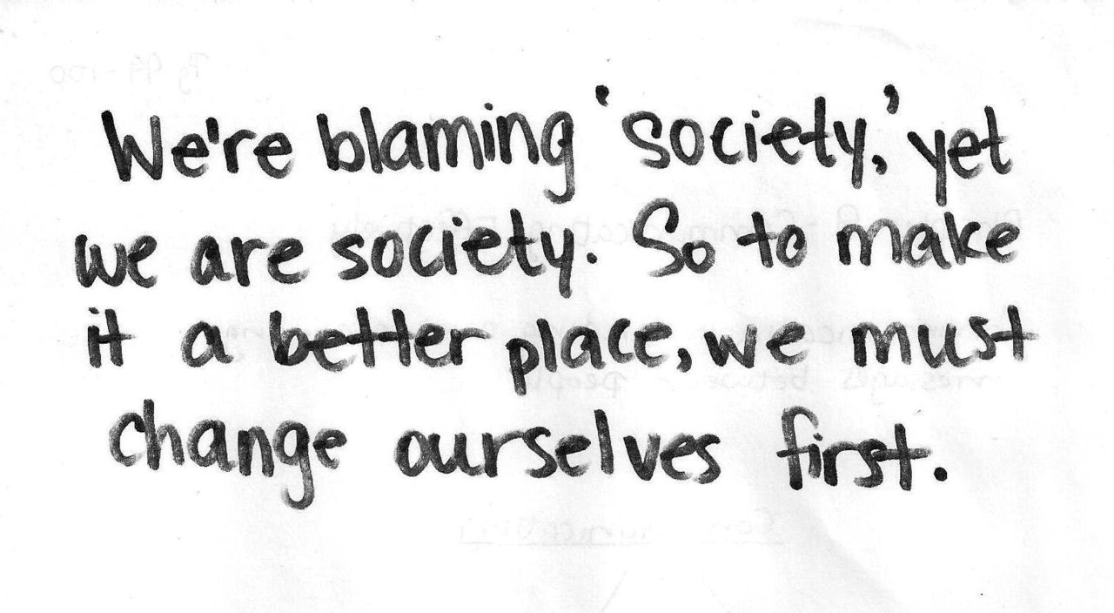

Slide 11
Social Project
Choose a social issue in your community, country or world
Then do your research: facts, numbers, people involved, groups…etc
Once you have done your research decide who to send your letter or email
Federal government: House or Senate
State government: Governor, Senate, or House
City of Aurora: Mayor, county board members
See me if you still are not sure who to address your issue to

