Slide 1
Yin/Yang Tangle project
The symbol has two sides which symbolize nature's balance of forces such as Good and Evil, Up and Down, Light and Dark.

Slide 2
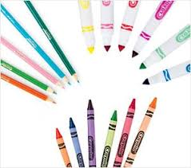
This project can be done with any materials you have around the house. I have examples with watercolors and pencil but use whatever you have, crayons, markers pens etc. The idea is to vary the value range (some areas dark, some medium, and some light)

Slide 3
You will need to draw a large circle that fills most of your paper;
this can be done in pencil. (If you don’t have a compass,
trace around a plate or any circular object you can find)

Slide 4
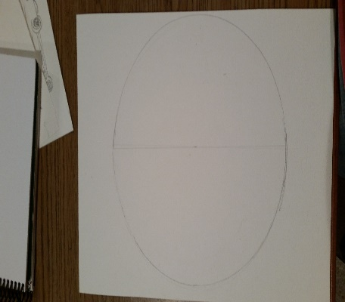
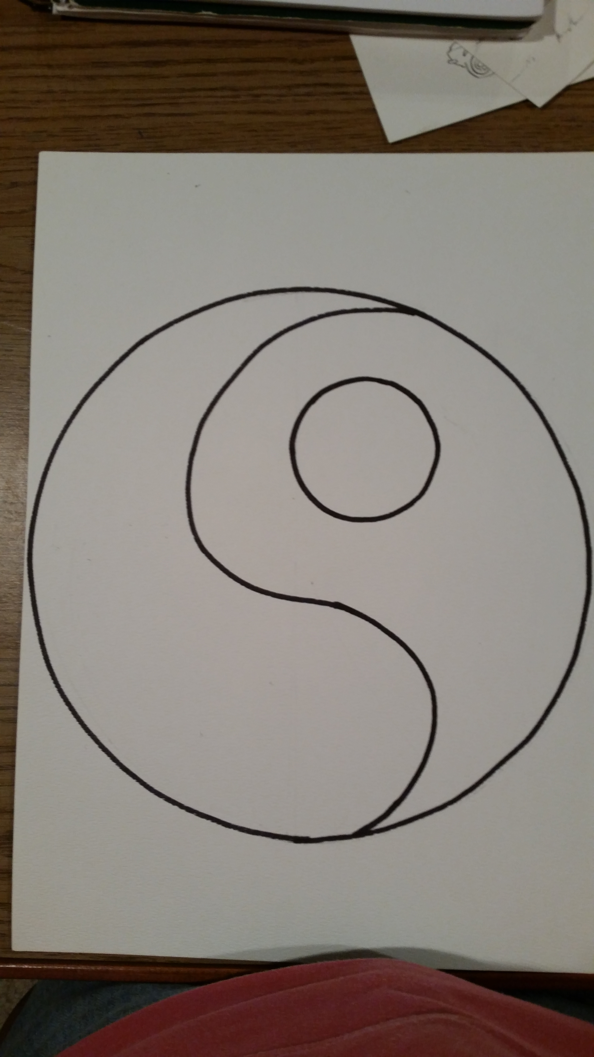
Using pencil lightly divide the circle in half. This will help you add the curving Yin and Yang lines.
Erase any extra lines after you have drawn out your Yin/ Yang shape.

Slide 5
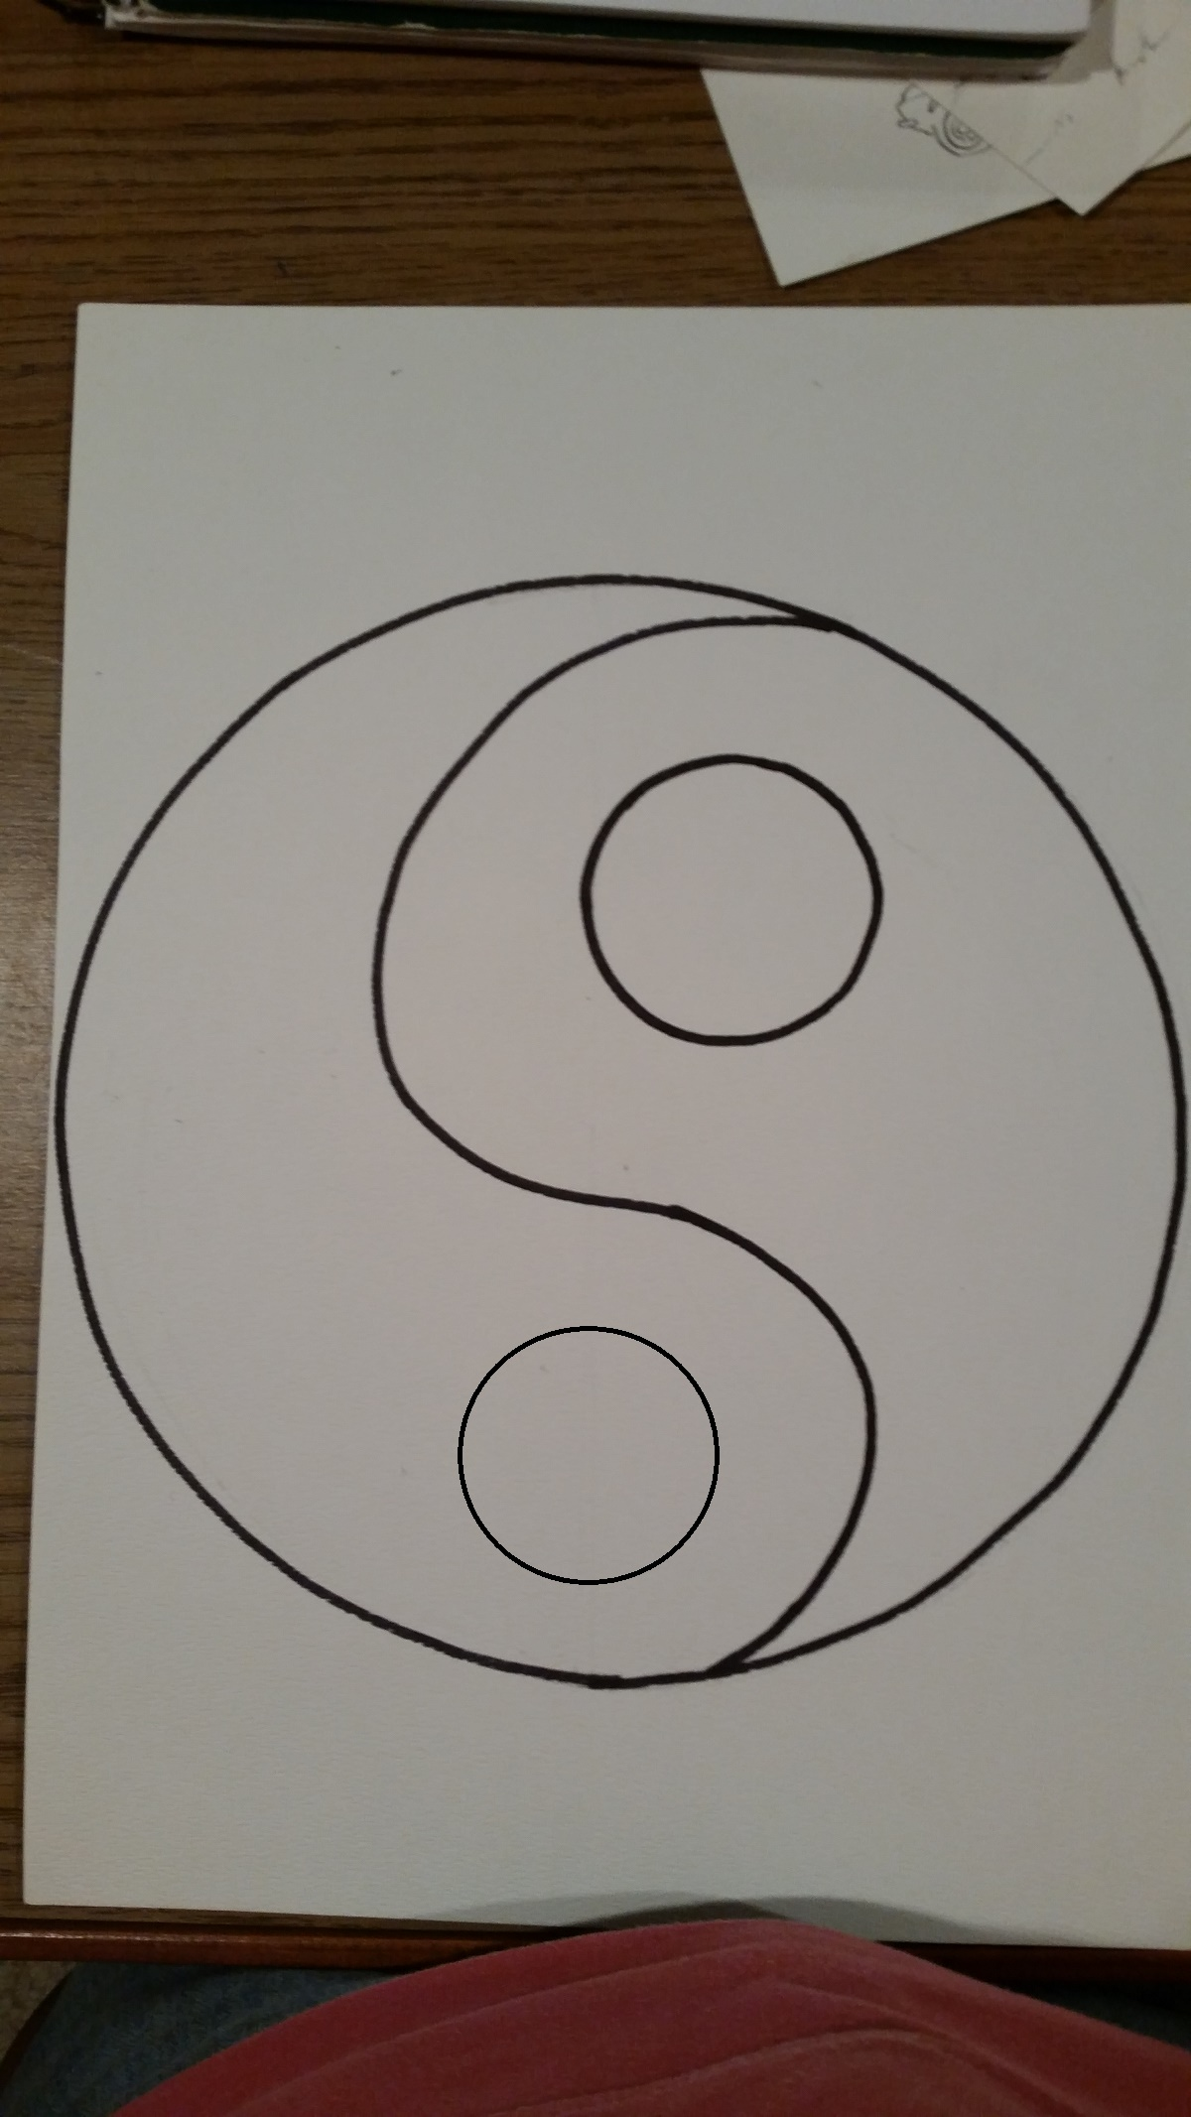
Add a smaller circle to both sides of your Yin/Yang design
(I traced around the bottom of a cup)

Slide 6
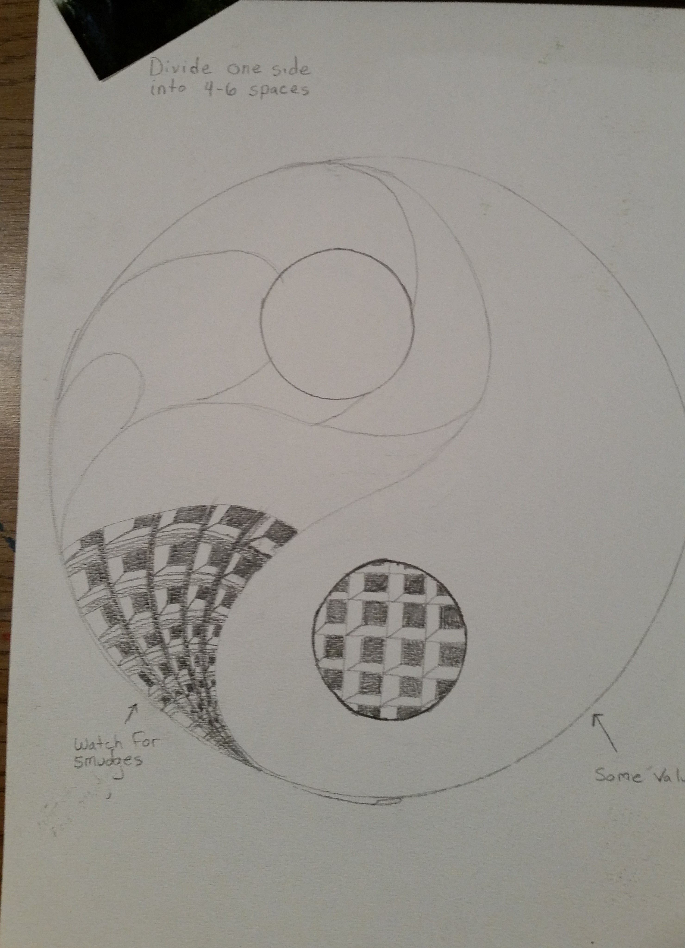
On one side you will fill in with 4-6 zentangle
designs on the other side you will add a design only in the small circle.

Slide 7
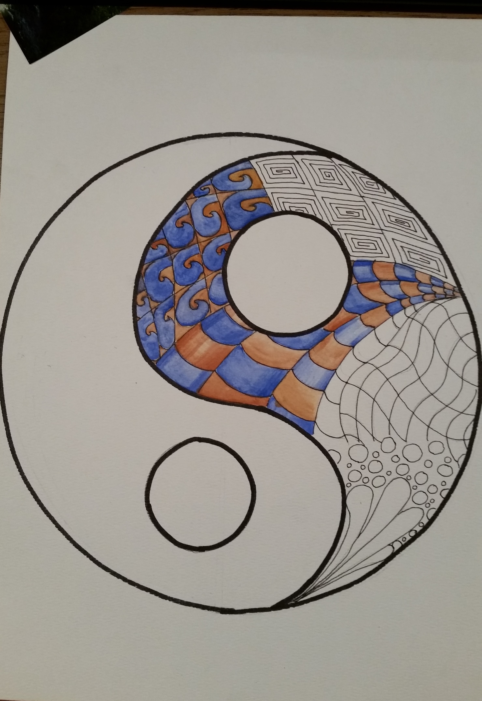
On one side only fill in the small circle with a zentangle
If you chose the small circle side for your designs fill it in with a solid color.

Slide 8
The completed project should be your best effort with the materials you had available
Did you?
Follow directions?
Put forth 100% effort?
Add creativity?
Keep it neat and is it complete?
I look forward to seeing your awesome designs!

