Slide 1
Blind Contour Drawing
Tips:
Do not press down hard with pencil
DO NOT lift your pencil
Focus on the object
Find a path and follow it with your eye
Have your pencil follow your eye’s path
Good luck!

Slide 3
Did you lift your pencil to draw the eyes??

Slide 9
Contour Question?
How many pedals on the flower?
A. 2
B. 8
C. 6
D. 5

Slide 11
Contour question?
Which side was the leaf on
A. Right
B. Left
C. What leaf?

Slide 12
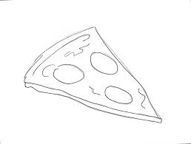

Slide 15
Contour Question?
Which side of the headphones was the cord coming out of?
A. Right
B. Left
C. There was not a cord

Slide 18
Contour question?
Which apple was cut in half?
A. left
B. Center
C. Right
D. None

Slide 22
Remember don’t lift the pencil

Slide 26
