Slide 1
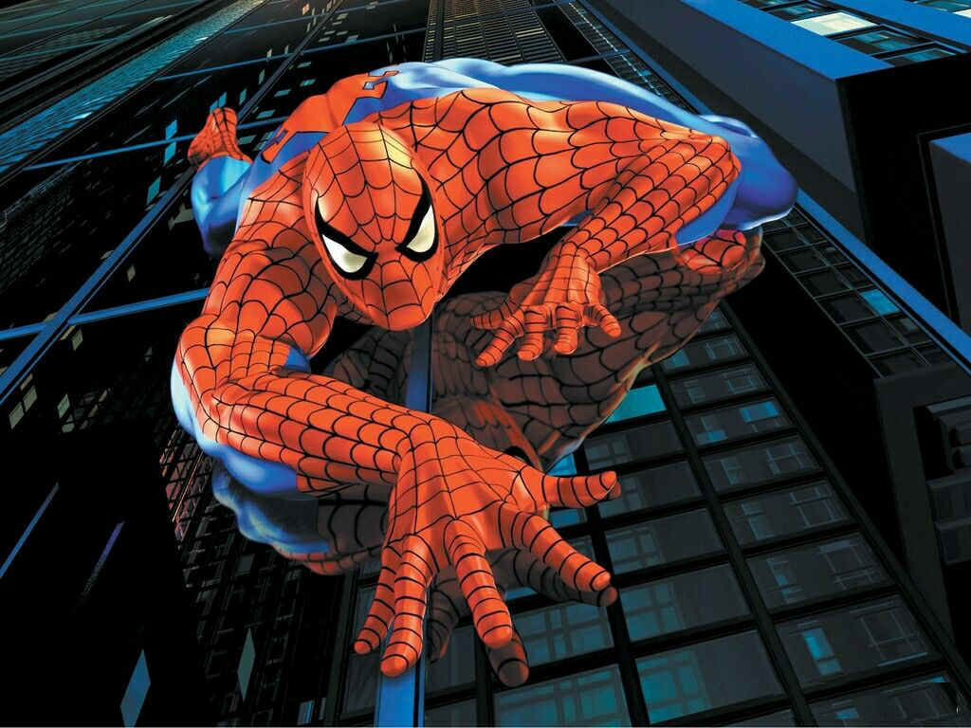
Perspective Drawing

Slide 2
What is Perspective?

Slide 3
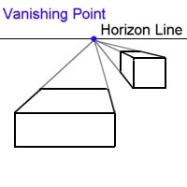

Slide 4
Perspective Drawing
Before perspective, paintings and drawings typically sized objects and characters according to their spiritual or thematic importance, not with distance.

Slide 5
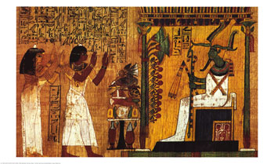

Slide 6
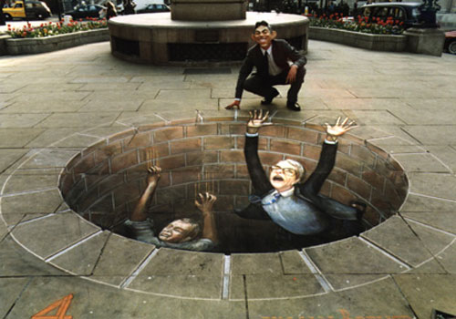
Optical Illusions are often used in art
Op

Slide 7
Perspective drawing creates the illusion of 3 dimensional objects on a 2 dimensional surface.

Slide 8
There are 4 common ways that artist create the Illusion of Space
Overlapping
Size
Placement
Detail

Slide 9
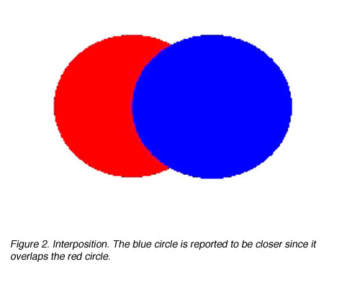
Which circle is closer?

Slide 10
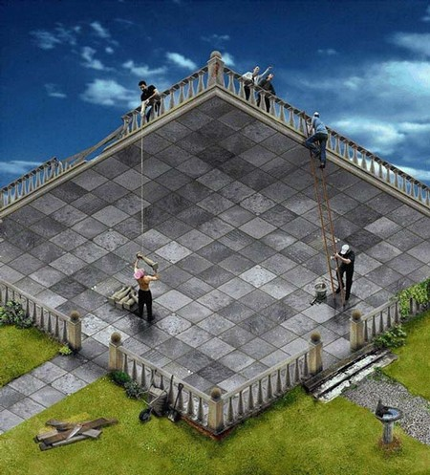

Slide 11
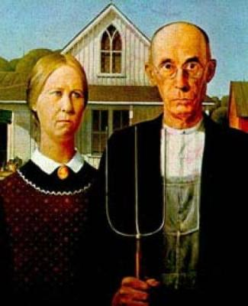
Placement

Slide 12
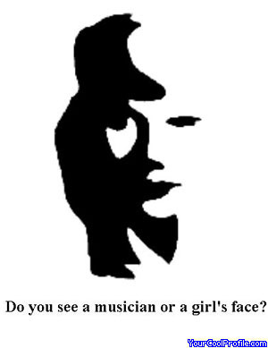
y

Slide 13
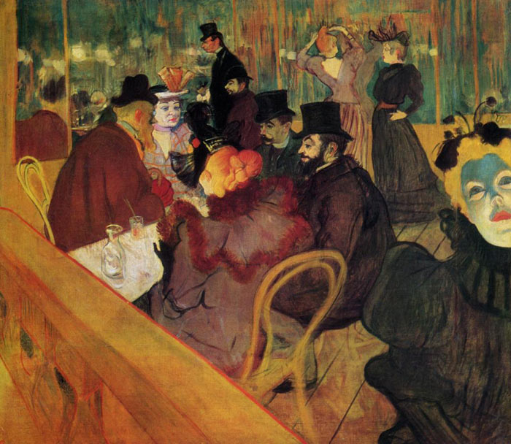
Detail

Slide 14
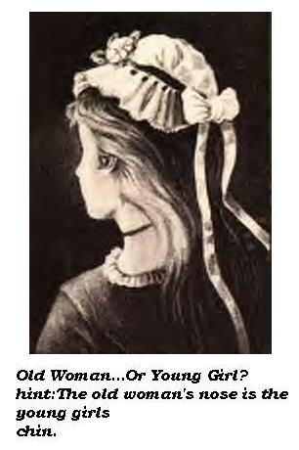
Optical Illusions

Slide 15
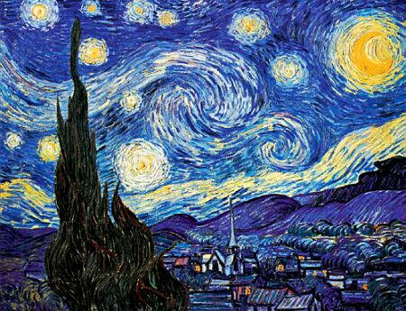
Size creates an Illusion

Slide 16
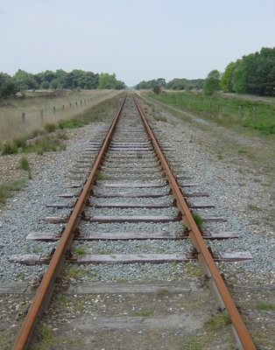
Will the tracks touch?

Slide 17
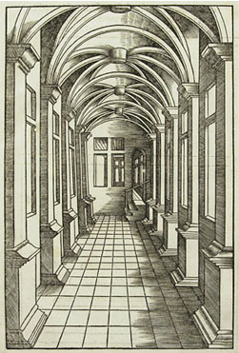
One Point Perspective

Slide 18
Linear or One point
Linear Perspective
A technique created by an architect during the Renaissance
It involves the use of lines converging at a vanishing point
Where do you suppose the vanishing point is in this picture?

Slide 19
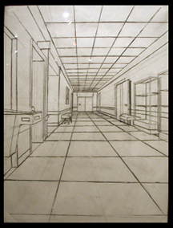
One Point Perspective

Slide 20
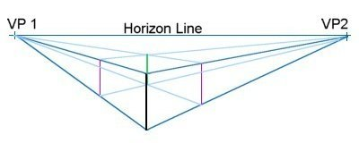
2 Point Perspective

Slide 21
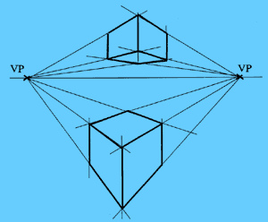
2 Vanishing Points

Slide 23
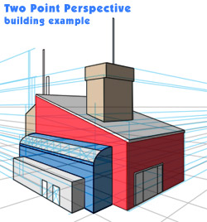

Slide 24
2 Point Perspective

Slide 25
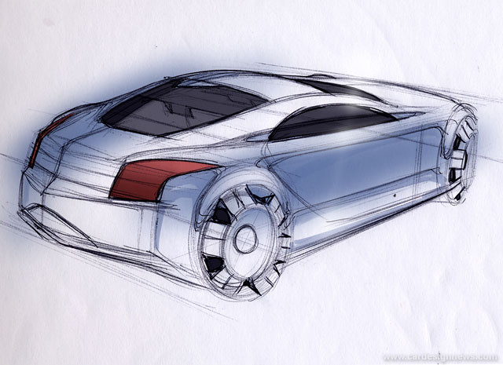
2 Point Perspective

Slide 26
Ready to try it??
Start by drawing a horizontal line across the middle of your paper.
Be sure your paper is turned landscape style (hot dog or long ways)

Slide 27
Foot notes
http://www.artdigitaldesign.com/3d-optical-illusion-popart/01surreal-images-streets/amazing-street-art01.htm
http://www.yourcoolprofile.com/Images/Optical_Illusions?page=2
http://archive.cardesignnews.com/studio/tutorials/040723quick-sketch/images/sketch3-10.jpg
www.drawingcoach.com/image-files/two_point_pe...

Slide 28
Foot notes
imagecache.allposters.com/images/pic/RIC/1500...
www.hemmy.net
Marvel Comics

